Slide 1
Dress For Success
Appearance and Nonverbal Communication
Transitions and Pathways Hub
Division of Community Education

Slide 2
Dress for Success
“Two things remain irretrievable: time and a first impression.”
- Cynthia Ozich
“Dressing well is a form of good manners.”
- Tom Ford

Slide 3
The Power of Professional Attire
Confidence and Professional Perception
Look good feel good
Importance of first impressions
Setting the Tone for Career Success
Nonverbal communication
Make-or-break a job opportunity
Personal Branding (Ex. Chanel)

Slide 4
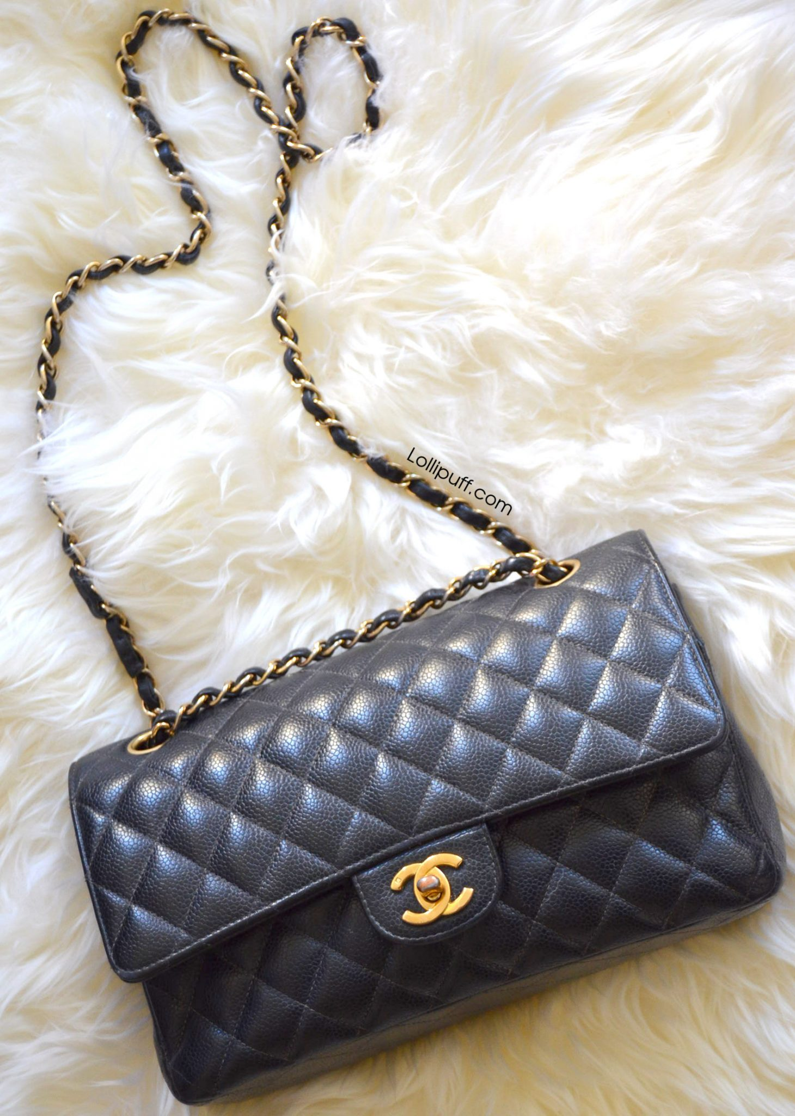
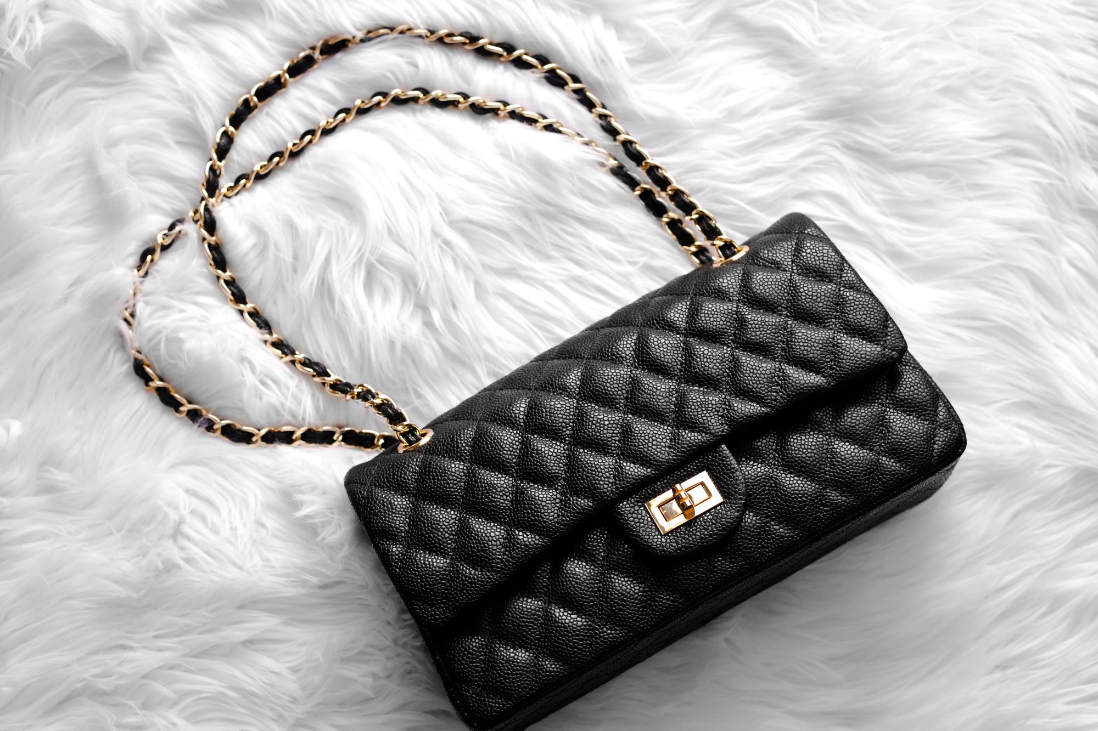
Personal Branding

Slide 5
Dressing Guidelines
Footwear Matters
Good condition & appropriate style.
Dress for the Role You Want
Your attire influences how others see your professional ambitions.
Appropriate Accessories/Colors
Keep it simple and classy.
Grooming and Personal Hygiene
Makeup, hair, and fitting.

Slide 6
Common Mistakes
Inappropriate Attire
Poor Grooming
Overly Trendy Outfits
Mismatched Accessories
Ignoring Industry Norms
Ill-Fitting Clothing
Ignoring Occasion Appropriateness

Slide 7
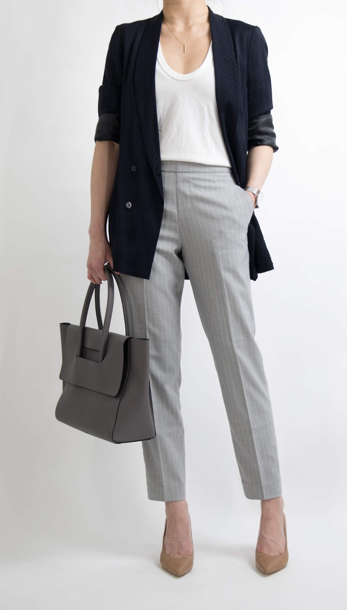
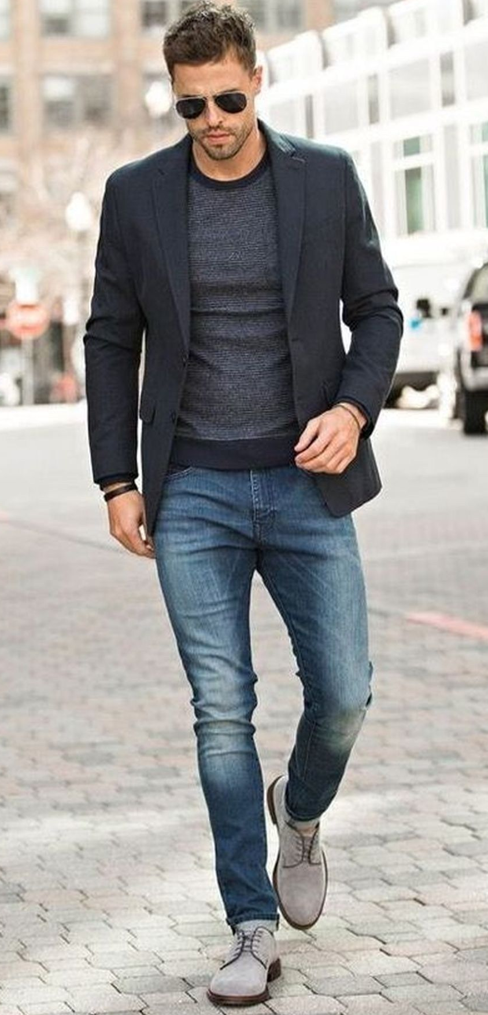
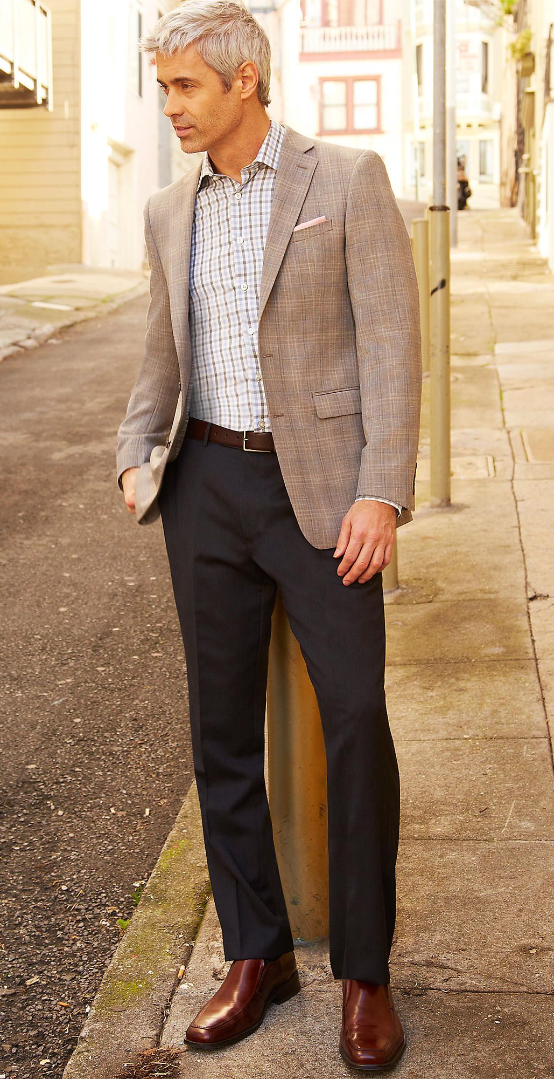
Examples of Multiple Professional Setting
There will be different occasions which require different levels of formality such as: Business Casual, Business Professional, or Business Formal.

Slide 8
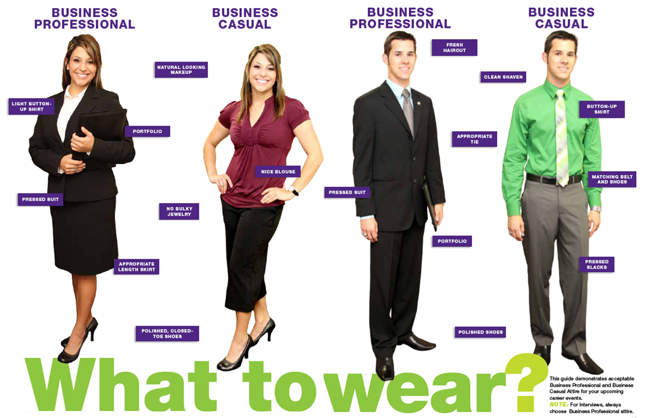
Continued

Slide 9
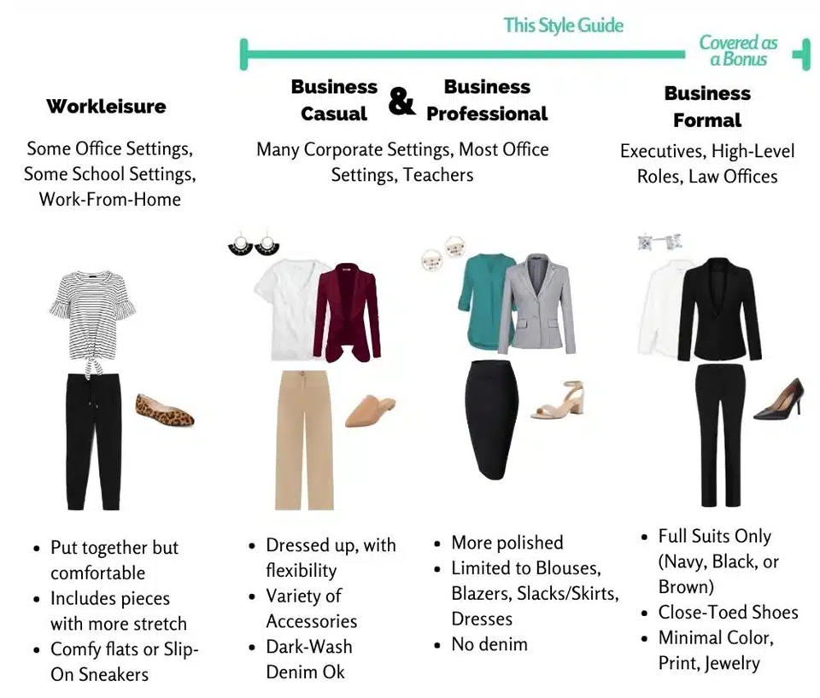

Slide 10
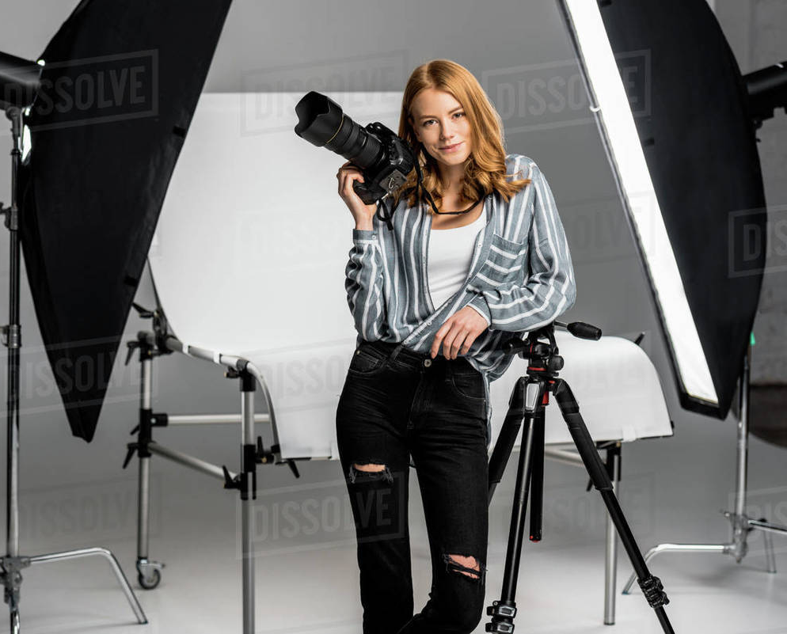
Industry-Specific Tips
CORPORATE ENVIRONMENTS
Opt for classic and conservative attire; suits, neutral colors, minimal accessories
CREATIVE INDUSTRIES
Allow for more individuality but still maintain a polished look; express yourself uniquely.
TECH AND STARTUPS
More casual; balance comfort with professionalism– think smart casual.

Slide 11
Industry-Specific Tips
HEALTHCARE AND SCIENCES
Scrubs or lab coats are standard; ensure cleanliness and adhere to the specific dress code guidelines.
CUSTOMER-FACING ROLES
Because of client interaction, prioritize a polished appearance; your attire contributes to the confidence and trust clients will have in your services.
PUBLIC SERVICE AND GOVERNMENT
Government settings lean towards formal attire; follow established dress codes to maintain a respectful and authoritative image.

Slide 12
Local Resources/Where to Shop
Thrift stores
Consignment shops
Churches
H&M
Walmart
Where hiring company indicates/advices.
(Could also provide it sometimes.)

Slide 13
Takeaways
It is not only about the clothes, but crafting a professional image.
Importance of consistency, industry awareness, and adaptability.
Small changes in attire can lead to significant importance in how you are perceived.

Slide 14
THANK YOU!

